Slide 1
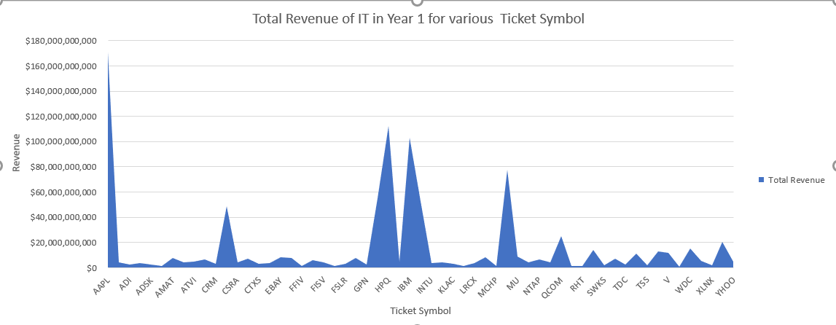
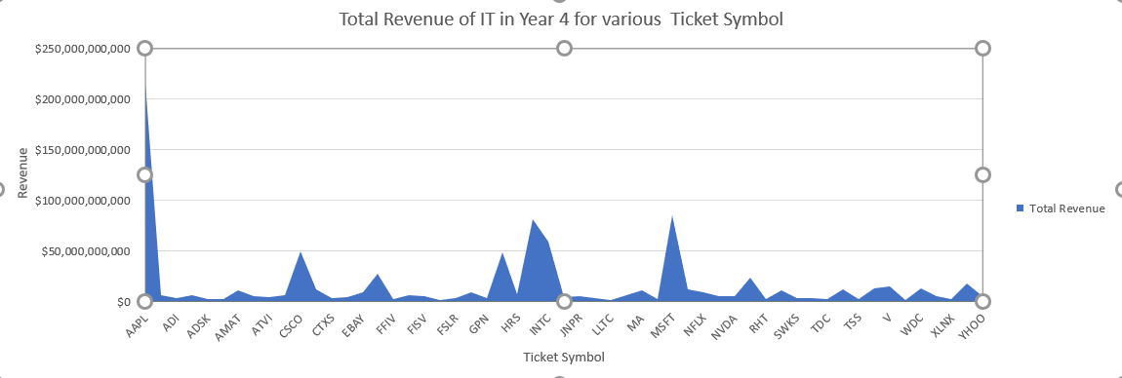
Does the total revenue in IT for various ticket symbol changes over the years
<visualization or summary statistics used for finding>
Here are the area charts for years 1 and 4 showing the total revenue of IT for various ticket symbols.
We can clearly see the revenue have increased for most of the tickets symbol.
The mean has increased overall, so the conclusion is the IT sector is growing over the years with the increase in revenue.

